Slide 1
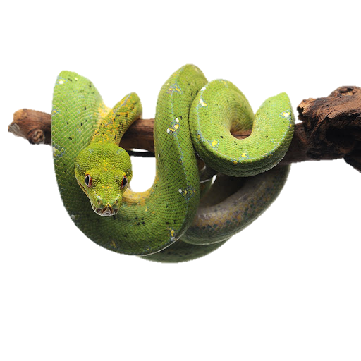


Introduction to Python (Part 1)
Instructor: Nasrin Akter
Teaching Assistant: Manisha Mandava

Slide 2

Nasrin Akter
Website: https://sites.create.ou.edu/nasrinakter/
Linkedin: https://www.linkedin.com/in/nasrin-akter-ece/
Ph.D. student in Electrical and Computer Engineering, The University of Oklahoma | Norman, Oklahoma.
MS in Computer Science and Engineering, Dhaka, Bangladesh.
BSc in Electronics and Telecommunication Engineering, Dhaka, Bangladesh.
Graduate teaching assistant.
Machine Learning Research Intern at Hearts for Hearing, Oklahoma City.
Corporate Outreach Chair, Society of Women Engineers
5 years Python experience, 8+ years of Industrial experience.
Current research: Machine Learning, Digital Image Processing, Computer Vision, Medical Image Informatics.
My skills in brief include:
• Data Visualization & Analytics: Tableau, Microsoft Power BI.
• Programming Language: Python, C/C++, MATLAB.
• Deep Learning Frameworks: Keras, TensorFlow.
• DBMS: MySql.
• IDEs: Jupyter Notebook, Google Colab,
• Deep Learning algorithm: ANN, CNN, RNN
• Transmission/ Telephony Technology: SDH Multiplexing, SS7 Signaling, Voice Codecs, H.323.
• Networking: HTTP, OSI model, TCP/IP, Routing protocols, IPv6 addressing and address Planning.
• Network management tools and simulation software: packet analyzer, Cacti.

Slide 3
Publications
Apriori-backed Fuzzy Unification and Statistical Inference in Feature Reduction| Springer
Prediction of Academic Performance Applying NN | IJACSA
Detection of Autism Spectrum Disorder applying Deep Neural Network
Projects
EEG data-driven Machine Learning for classification of stroke and healthy subjects
Classification the Gait cycle images to detect diabetic neuropathy among cancer patients
Automatic Brain Tumor segmentation on MRI images using Deep Learning
Automatic Breast Tumor Segmentation And Classification: A Deep Learning Approach

Slide 4
Teaching Assistant
Manisha Mandava
M.S. in Computer Science
(OU, 2021 - 2023)
Graduate teaching assistant

Slide 5
Schedule
Day 1
Install Python and open IDLE
Interactive and batch mode
Docstrings and comments
Learn the basics of Python syntax
Variables
Data types
Strings
Day 2
Review the basics of Python syntax
Gene sequence exercise
Lists
Conditional statements
Loops
You don’t need to know what any of these mean yet!

Slide 6
Introduction
Course Objectives
Give scientists comfort and confidence with computation
Learn and practice computational skills for your future or current research
Basic Python programming
Learn how to use IDLE to execute Python commands
Learn the basics of Python syntax
Explore Python data types, create and manipulate variables, and use loops and conditionals in a Python program

Slide 7
Introduction
What you need to succeed:
A logical and organized way of thinking (or at least organized notes for your future self!)
Determination
Practice, practice, practice
What you don’t need:
A math background
Previous programming experience

Slide 8

Let’s get started!!

Slide 9
What is Programming?
Providing a set of instructions for a computer to execute
A way to automate tasks, perform difficult data analysis, document the process, and save time
There are many programming languages and applications
Python
Java
R
Perl

Slide 10
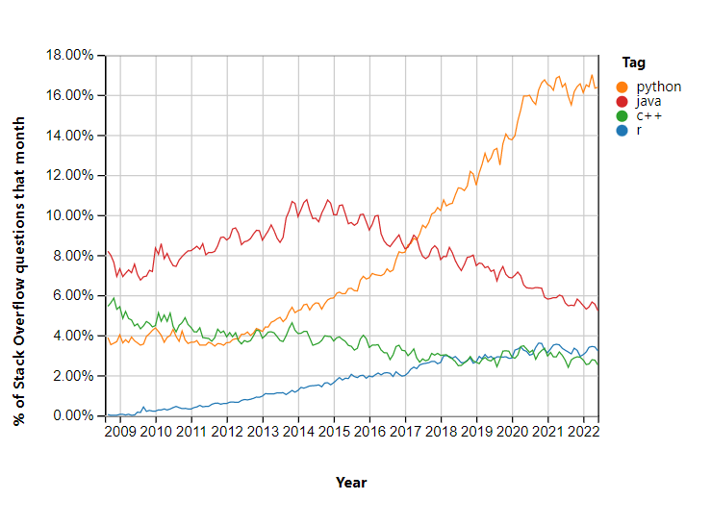
Why Python?
Easy to learn
Popular
Free and open-source
Interchangeable between Windows, Linux, and iOS
High-level and object-oriented
Many applications use Python

Slide 11
What is a Program(Script)?
A detailed set of instructions for how to do something
Definitions/symbols:
pi = 3.1416
Actions
Area = pi x radius^2
Loops
Repeat 2 times
Repeat until…
Conditional
If (something) do (something)
Results (Output)

Slide 12
Setup Environment

Slide 13

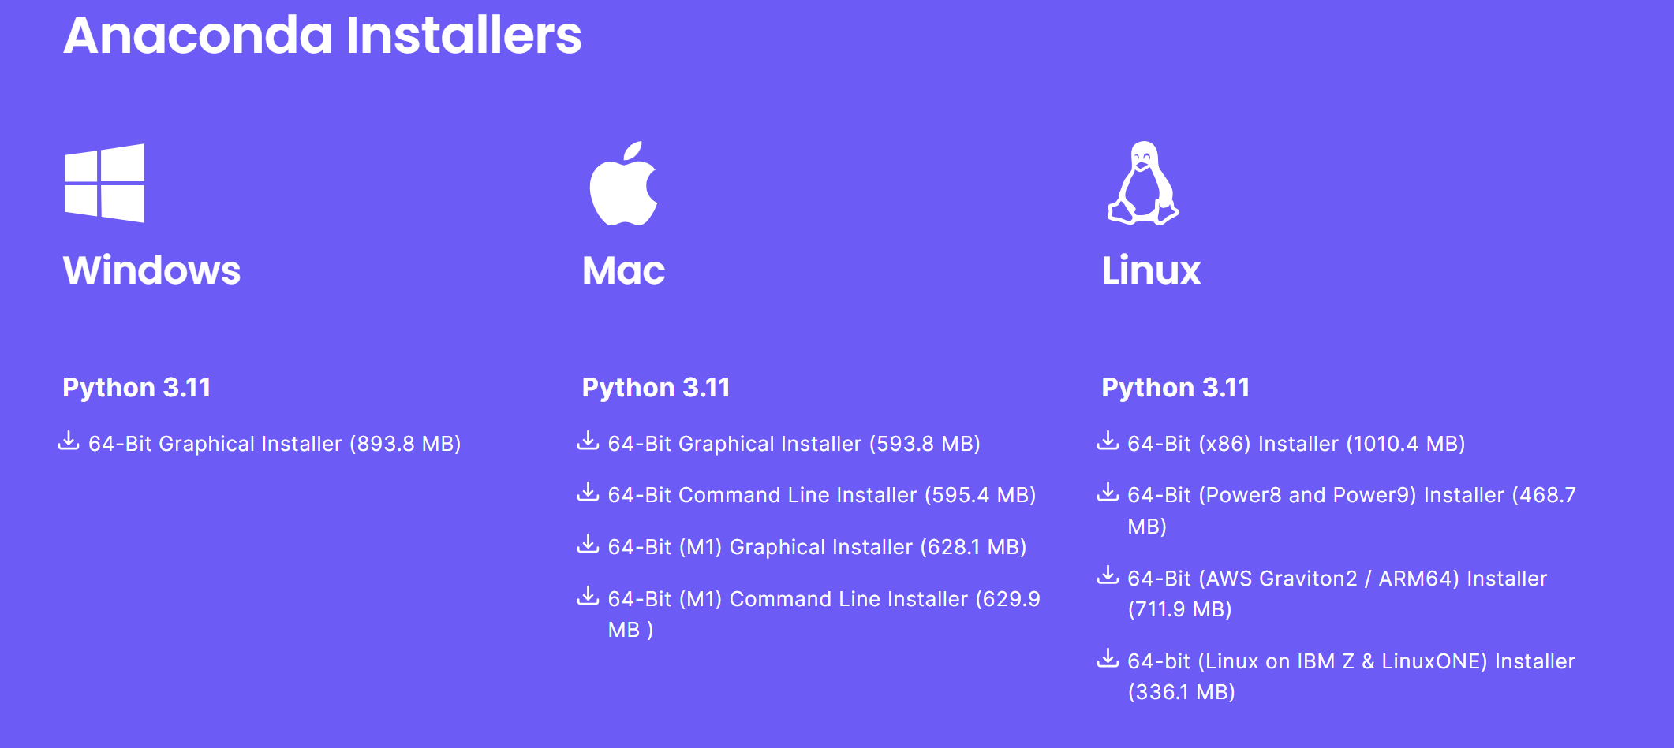
Download and Install Anaconda
a distribution of the Python and R programming languages for scientific computing, that aims to simplify package management and deployment.
The distribution includes data-science packages suitable for Windows, Linux, and macOS.
https://www.anaconda.com/download

Slide 14
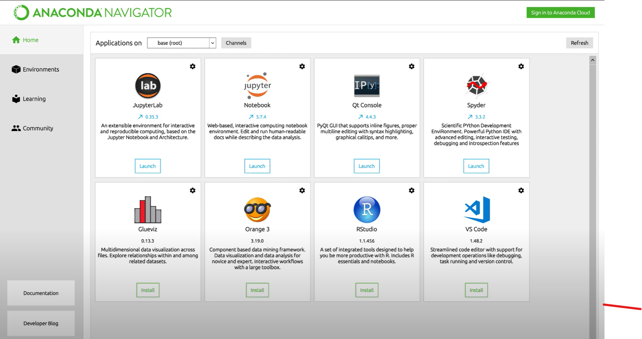
Anaconda Environment

Slide 15
Execution Mode
Two Basic Python Execution Modes:
Interactive mode (front-end)
Batch mode (a script)
a terminal or a console where as soon as you type a python command and press enter it's going to execute immediately. Use JupyterLab or Jupyter Notebook.
a file editor or an IDLE where you're going to be writing a lot of code and then running all of that code at once. Use like spider or vs code to write some python code and then use the python interpreter to execute all of the code in that file.

Slide 16
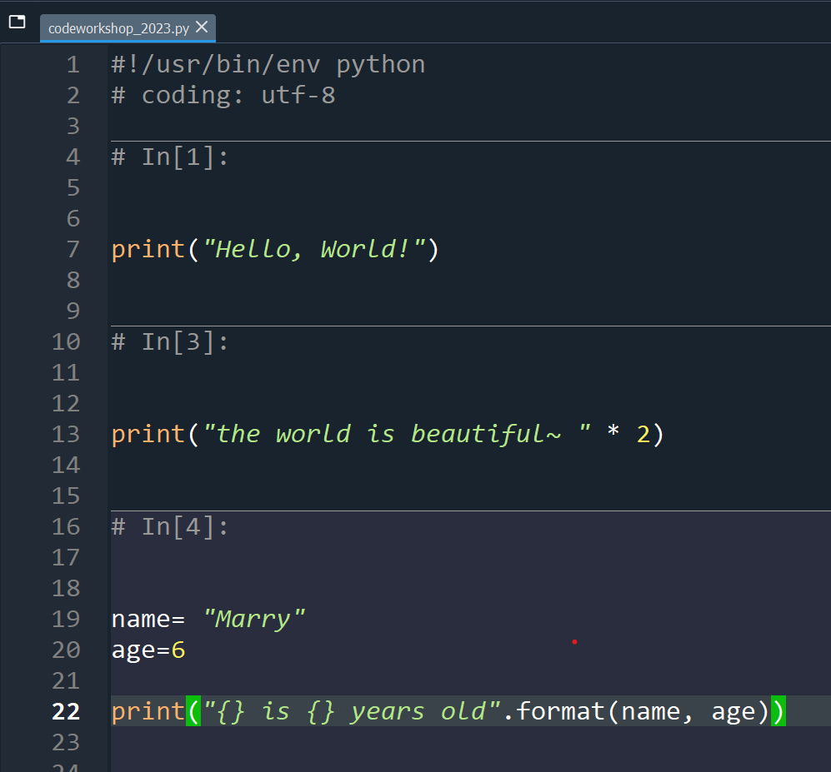
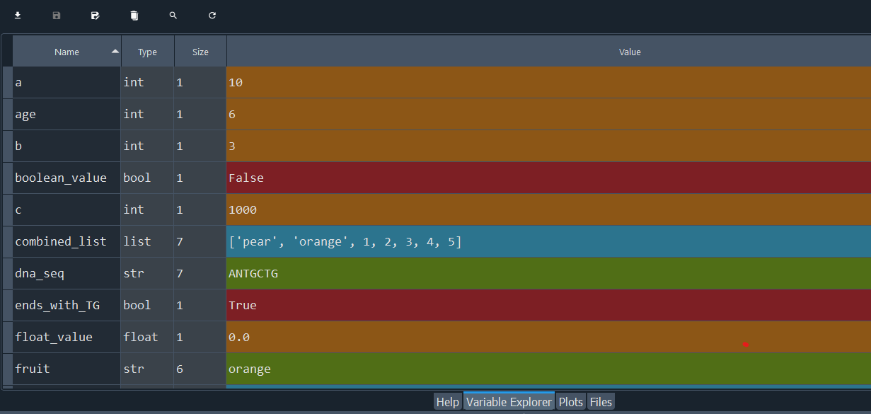
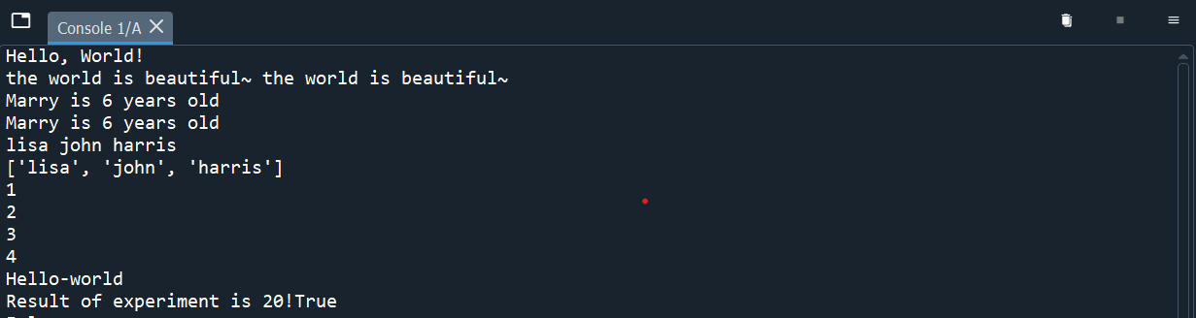
Batch Mode
Editor
Variable Explorer
Console
https://docs.spyder-ide.org/5/videos/first-steps-with-spyder.html#:~:text=You%20can%20see%20that%20it,open%2C%20edit%20and%20run%20files.

Slide 17
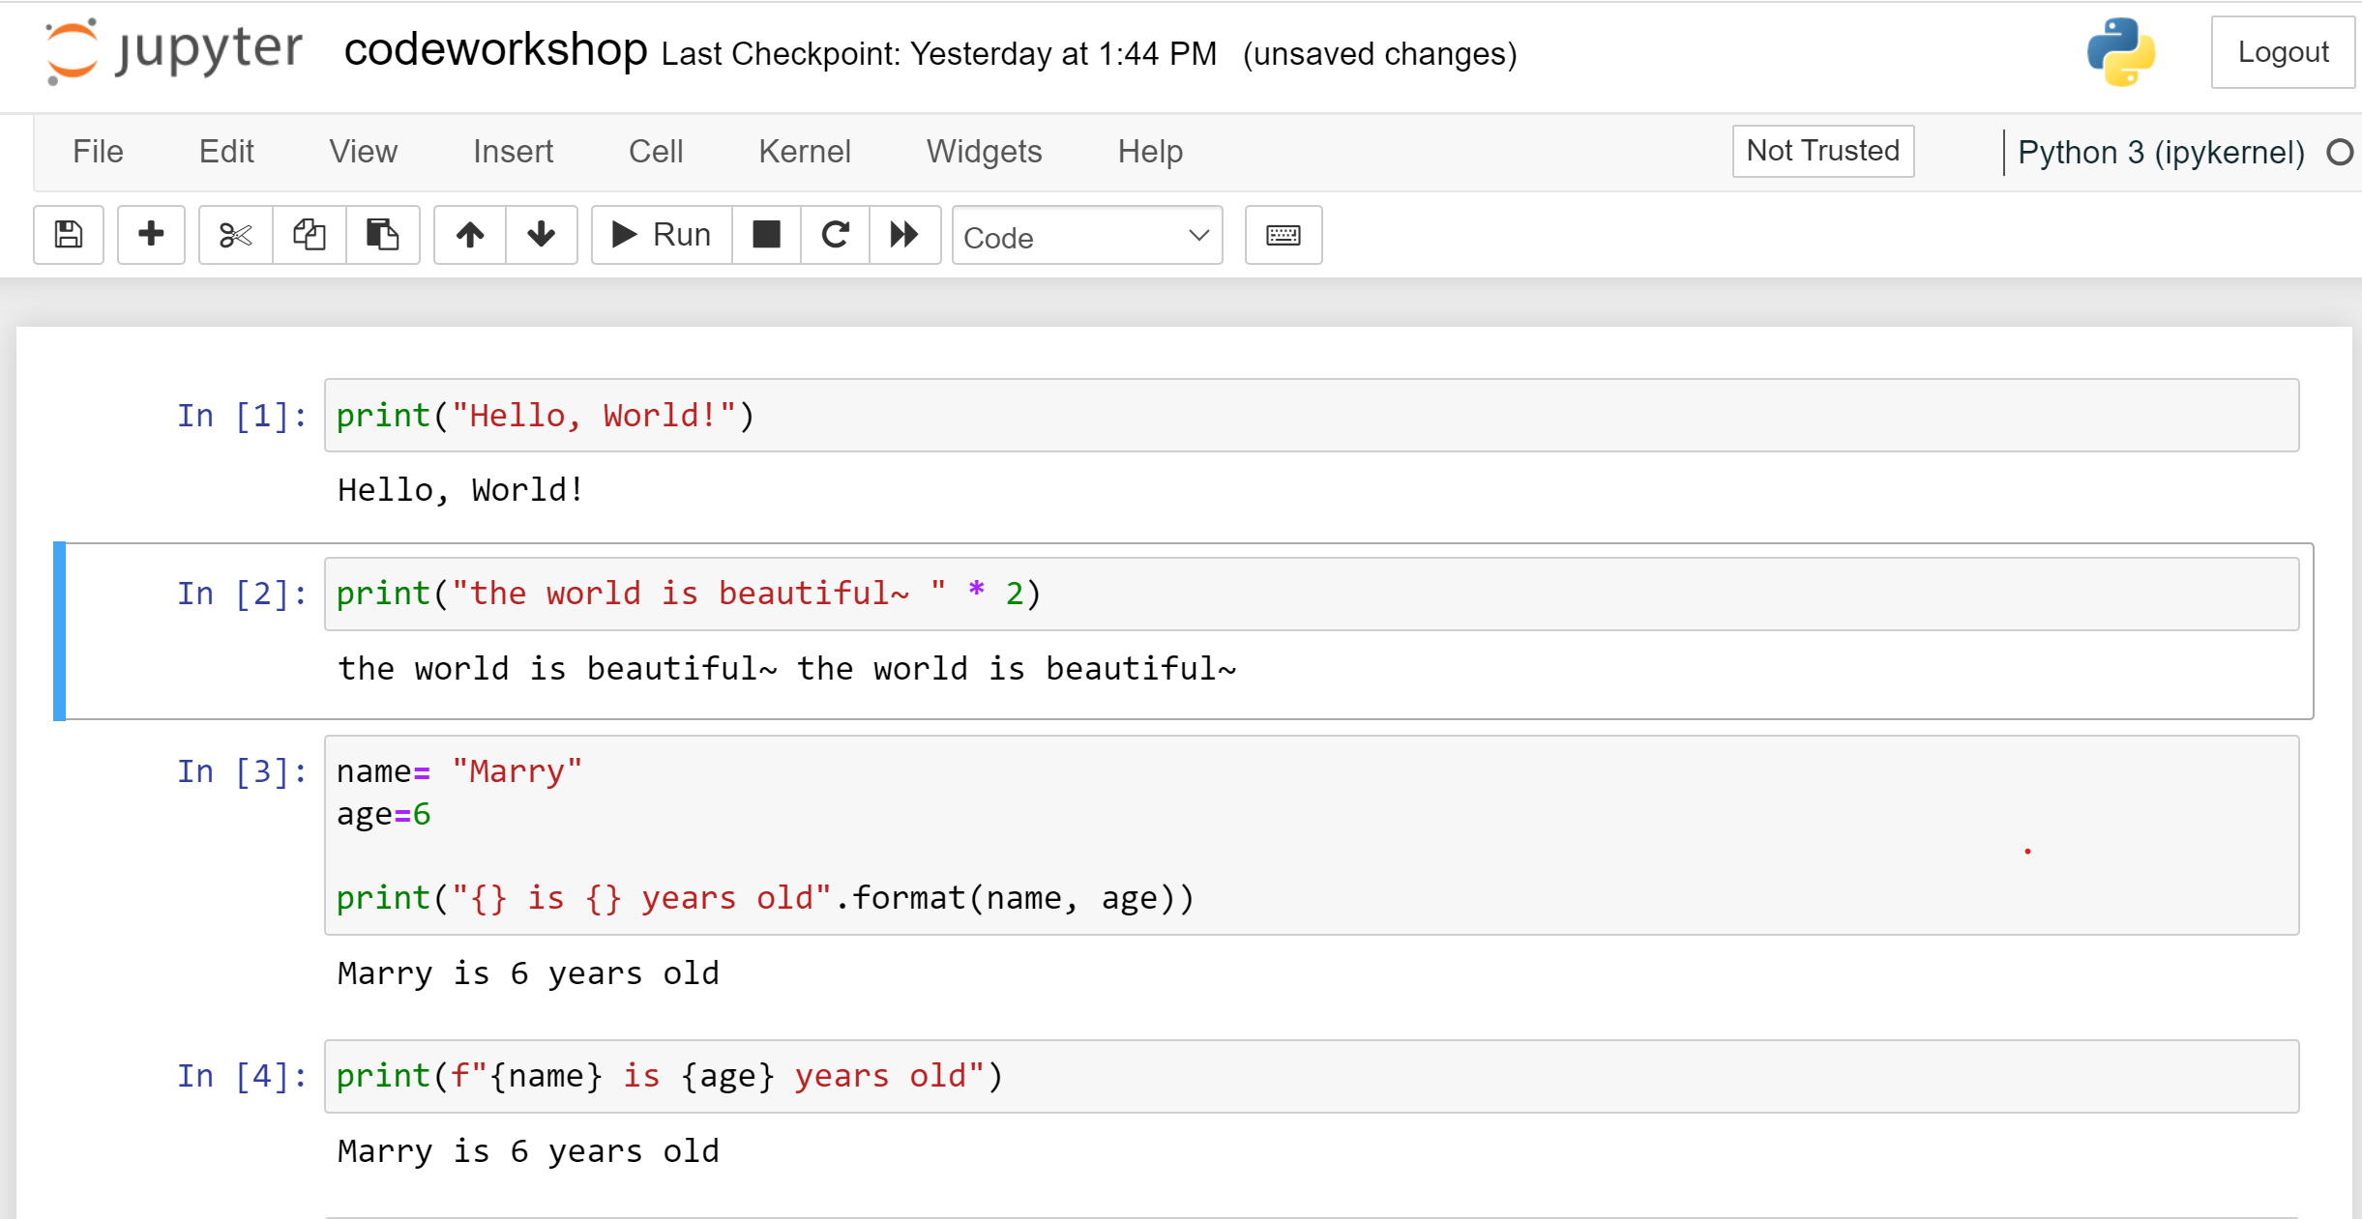
Interactive Mode
https://docs.anaconda.com/ae-notebooks/user-guide/basic-tasks/apps/jupyter/index.html

Slide 18
IDLE (Integrated Development and Learning Environment)
IDLE is a program used to write and execute Python code
For windows:
Navigate to the Start Menu at the bottom left corner of the screen
Type ‘IDLE’ in the search bar and click on the application
For Mac:
Open the Finder and type ‘IDLE’ in the search menu
You can also open the Applications folder in the Finder and find the IDLE program

Slide 19
Execution in Interactive Mode
Two Basic Python Modes:
Interactive mode (front-end)
Interactive mode is a command line shell which gives immediate feedback for each statement
Executing code in the interactive window happens in 3 steps:
1. Python reads the code entered at the prompt (>>>)
2. Python evaluates the code
3. Python prints the result and waits for more input (>>>)
>>>print(“Hello, world!”)
Hello, world!
>>> 1 + 1
2

Slide 20
Python print( ) function
A Python function is a code that performs a task and can be invoked by a name. For example: print( ); sum( ); len( )
The print( ) function prints the given object to the standard output device (screen)
You need the print( ) function to see variable values, results, list contents, etc. ** Especially important in batch mode

Slide 21
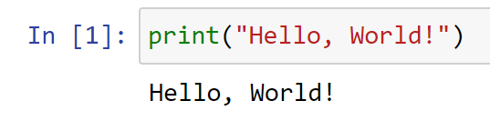
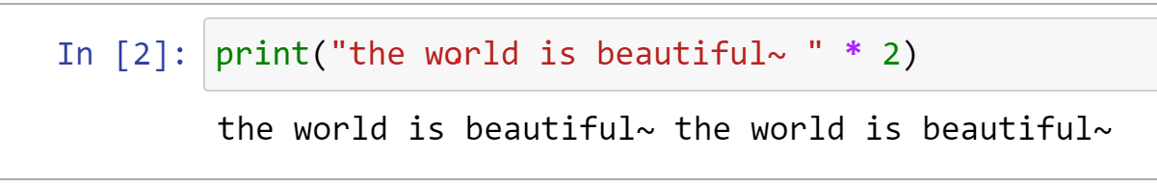
Python print( ) function
The function accepts several arguments as shown below with their default values:
print(*objects, sep=' ', end= '\n')
*objects : The thing to be printed is represented by the first argument *objects and can be basically anything. It is commonly a string but may be an integer, a float, a variable, a list, or a dictionary, among others. The print() function can also take more than one object.
Normal string operations may be used within the function. As an example, you can multiply a string by an integer as shown here

Slide 22
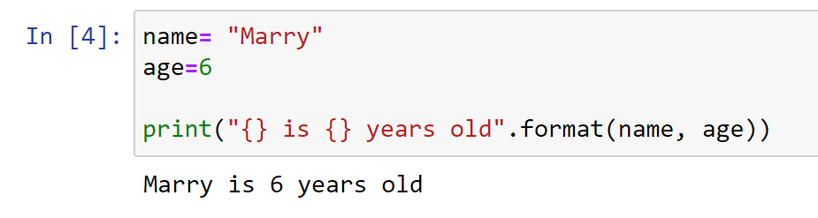
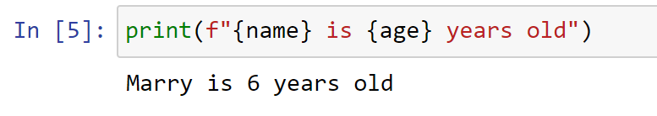
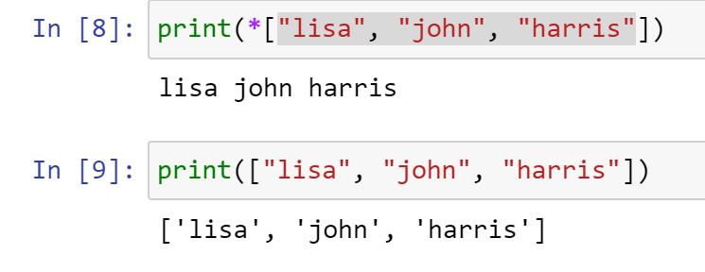
Python print( ) function
str.format(), where the replacement fields are indicated with curly braces
Similar to this is f-string formatting, but more compact
starred expression is useful If to print an iterable object like a list or an array

Slide 23
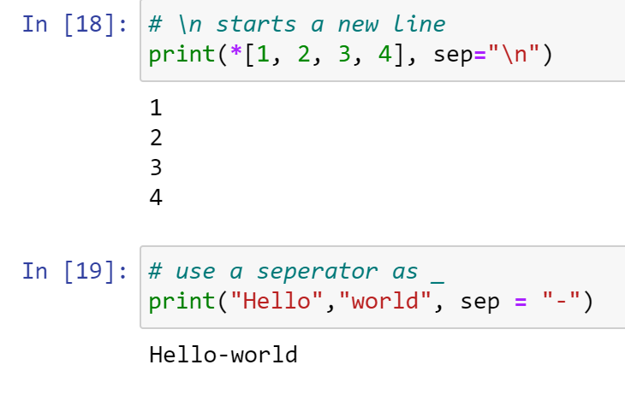
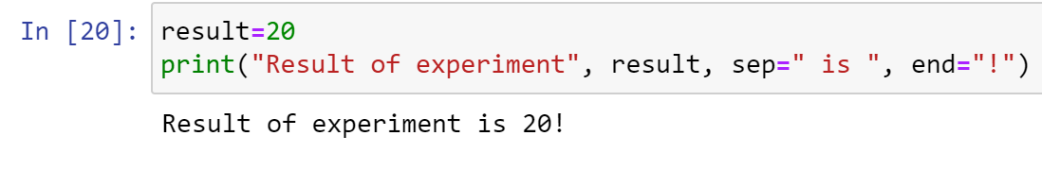
Python print( ) function
Sep: The second argument of the Python print() function defines the separator. If more than one object is given as the first argument, then sep defines what delimiter to place between them.
end: The end keyword allows you to define something to be printed automatically at the end of the output.

Slide 24
Python Programming/Batch Mode
Two Basic Python Modes
Batch Mode (script)
The Python Shell (interactive mode) is convenient for executing a few simple commands. If you need to give the computer more complex instructions, it is a good idea to write a script. A script is a set of instructions you can easily edit and run.
When a program is executed from such a text file, rather than line-by-line in an interactive interpreter, it is called batch mode.
1. Go to File >>> New File to create a new script
2. In your script, write: print(“Hello!”)
3. Go to File >>> Save As… to save your script. Choose a location and a name. Be sure it saves as a .py file extension
4. Go to Run >>> Run Module to run your script. The Python shell will reopen and display: “Hello!”

Slide 25
Comments and Docstrings
Programming Best Practices: Commenting and Clarity
The top priority is making your program easy to understand
Makes it possible to verify correct outputs
Simplifies modifying and updating
Promotes reuse and sharing
Requirements
Docstrings: Block quotes with triple quotation marks are called docstrings. They are used in the interpreter to provide help.
Comments: Introduced by using the # symbol. Use comments to describe the steps in your program, helpful notes or clarification, and titles.

Slide 26
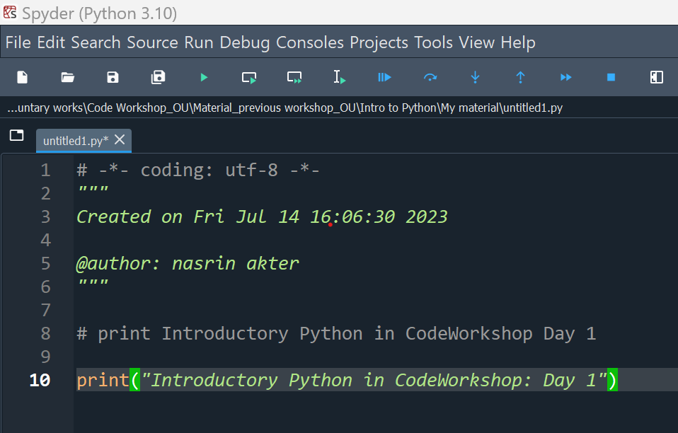
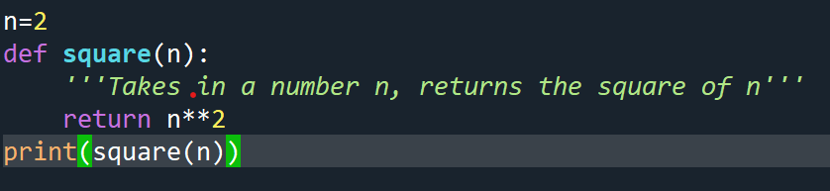
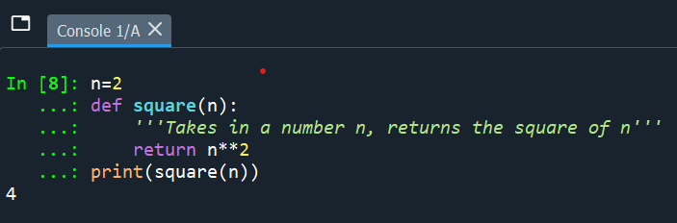
Comments and Docstrings
Comments
Docstrings

Slide 27
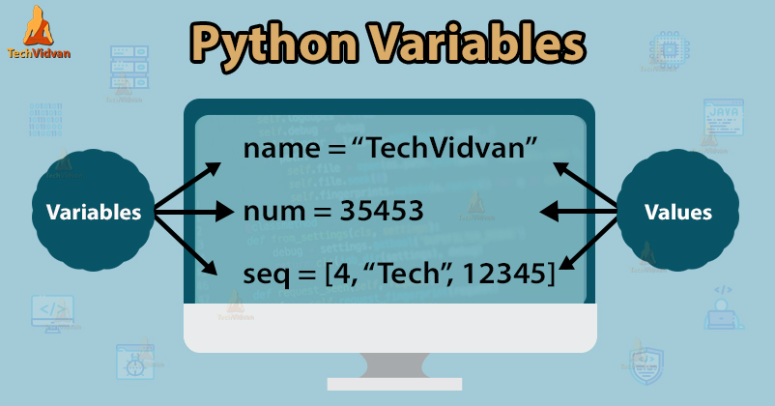
Variables

Slide 28
Variables
A variable is a value you can change and access throughout your script (variables are just names)
Variable names can only contain these characters:
Lowercase letters
Uppercase letters
Digits (0 through 9)
Underscore(_)
Names cannot begin with a digit
1
1a
1_

Slide 29
Variables: Assign a Variable
The assignment operator is the equal sign ( = )
Pick variable names that are distinct and memorable
course = “Python 101”
num_students = 30
greeting = “Hello world”
Variables are case sensitive (greeting ≠ Greeting)
Mixed case:
numStudents = 30
introPythonCourse = “This course is a formal introduction to Python”
listOfNames = [“Angie”, “Sanjana”]
Lower case with underscores*:
name_of_class = “Introduction to Python”

Slide 30
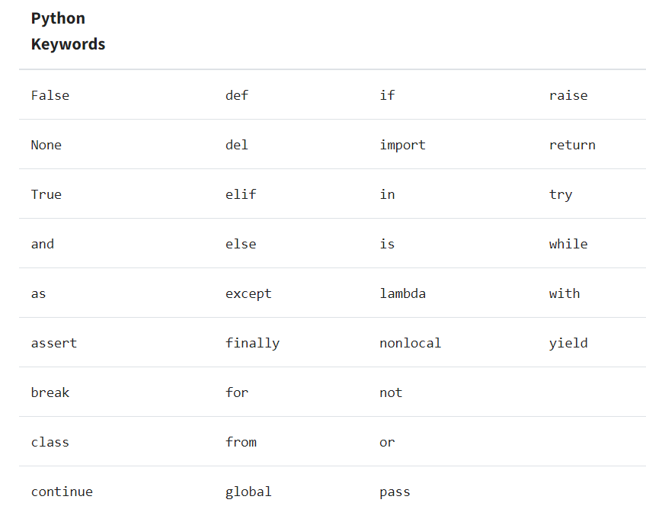
Variables: Assign a Variable
Python has a set of reserved words that cannot be used as variable names

Slide 31
Variable Names
Which of the following is a good variable name for a variable holding a value for “meters per second”?
m/s = 35
meters_per_second = 35
metersPerSecond = 35
m = 35
speed = 35

Slide 32
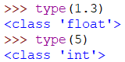
Basic Variable Types
Numbers
Integer numbers
A whole number (not a decimal)
Examples:
100
-7
1
1863210897465
Floating point numbers
Numbers that contain a decimal
Examples:
3.1416
0.7851
1.0

Slide 33
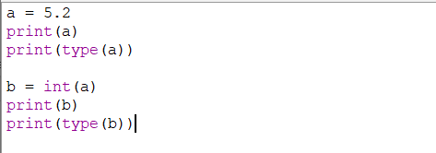
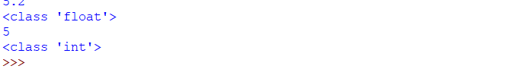
Basic Variable Types
Numbers
You can check the variable type using the function type( )
You can change the variable type (with certain exceptions) by using the variable type as a function
Convert to integer: int( )
Convert to float: float( )

Slide 34
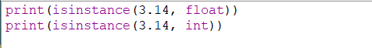
Basic Variable Types
Boolean
True
False
Some functions only return a True or False
Example: isinstance(object, type)

Slide 35
Basic Variable Types
Strings
A sequence of zero or more characters that are enclosed within a pair of quotation marks.
Single quotes, double quotes, triple single quotes, triple double quotes
Strings are immutable (‘read-only’)
A string can contain letters, digits, punctuation, white spaces, and other characters.
my_string = “Hello world! 123 True”

Slide 36
Basic Variable Types
Typecasting between variable types
From | To | Function | Possible?
Integer | Float | float( ) | Yes
Integer | String | str( ) | Yes
Integer | Boolean | bool( ) | Yes, but…
Float | Integer | int( ) | Yes
Float | String | str( ) | Yes
Float | Boolean | bool( ) | Yes, but…
String | Integer | int( ) | Yes, if…
String | Float | float( ) | Yes, if…
String | Boolean | bool( ) | Yes, but…
Boolean | Integer | int( ) | Yes - binary
Boolean | Float | float( ) | Yes – binary
Boolean | String | str( ) | Yes

Slide 37
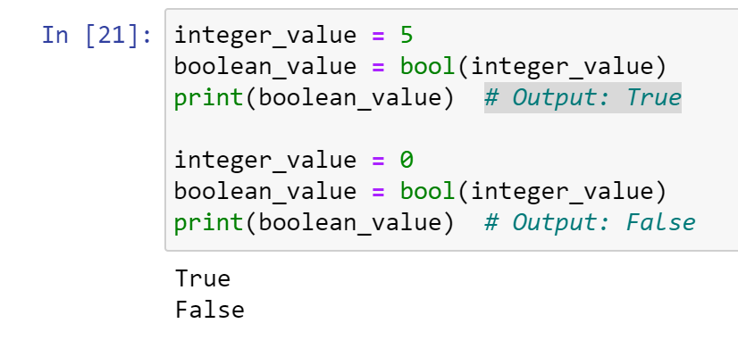
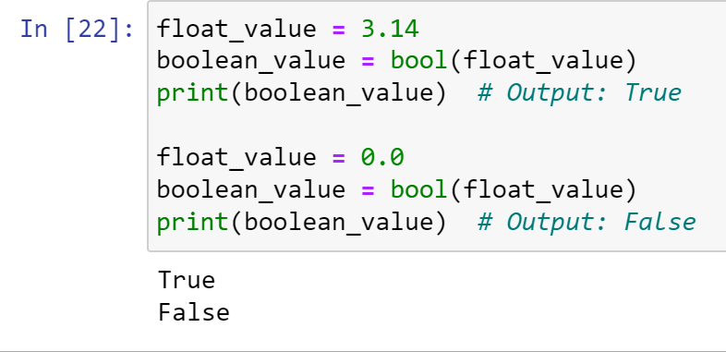
Basic Variable Types
Integer to Boolean: Any non-zero integer results in True, while 0 results in False.
float to Boolean: Similar approach

Slide 38
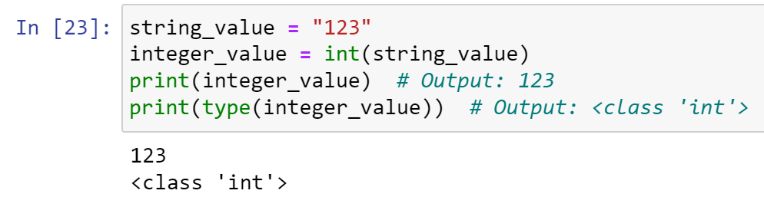
Basic Variable Types
String to integer: Possible when there is numerical expression.

Slide 39
Operators
An operator is a symbol that indicates a calculation using one or more operands
Operator | Description | Example
+ Addition | Adds values on either side of the operator | >>> 5 + 2 7
- Subtraction | Subtracts right hand operand from left hand operand | >>> 5 – 2 3
* Multiplication | Multiplies values on either side of the operator | >>> 5 * 2 10
/ Division | Divides left hand operand by right hand operand | >>> 5 / 2 2.5
// Integer Division | The whole number smaller than the floating point result | >>> 5 // 2 2
% Modulus | Integer remainder after b/a | >>> 5 % 2 1
** Exponent | Performs exponential (power) calculation on operators | >>> 5 ** 2 25

Slide 40
Operators
Operator | Description | Example
= | Assigns values from right side expression to left side operand | c = a + b assigns c the values of a + b
+= Add AND | It adds right operand to the left operand and assign the result to left operand | c += a is equivalent to c = c + a c += 1 is equivalent to c = c + 1
-= Subtract AND | It subtracts right operand to the left operand and assign the result to left operand | c -= a is equivalent to c = c - a
*= Subtract AND | It multiplies right operand to the left operand and assign the result to left operand | c *= a is equivalent to c = c * a
/= Divide AND | It divides left operand to the right operand and assign the result to left operand | c /= a is equivalent to c = c / a
//= Integer Division AND | It performs floor division on operators and assign value to the left operand | c //= a is equivalent to c = c // a
%= Modulus AND | It takes modulus using two operands and assign the result to left operand | c %= a is equivalent to c = c % a
** Exponent | Performs exponential (power) calculation on operators and assign value to the left operand | c **= a is equivalent to c = c ** a

Slide 41
Operators
Box Model
Beginner programmers are often puzzled by syntax such as:
b = 2
b = 4 + b
print(b)
Before you run this, what do you think the answer is?

Slide 42
Operators
Box Model
Think of variables as boxes
A box is a location in the computer’s memory
The variable name is a label on the box, or the box’s name
Assigning b = 2 copies a value from a temporary location into the box
tmp
tmp
2
2
b = 2
b
b
2

Slide 43
Operators
Box Model
b = 2
b = 4 + b
4 is loaded in a temporary space
b is added to 2 in the temporary space
The result is copied back into b
tmp
tmp
4
2 + 4
6
4 +b
b = 4 + b
b
2
b
2
b
6
tmp = 4 +b
b = tmp

Slide 44
Operators
Box Model
The box model is conceptual
You can check where the variable is stored using the id( ) function
Try this:
>>>n = 6 >>>n = n + 4
>>>id(n) >>>id(n)
1349663056 1349663120
The memory address changes when the value of n is changed

Slide 45
Operators
Arithmetic Operators:
# Arithmetic operators:
a = 10
b = 3
# Addition
c = a + b
print(c) # Output: 13
# Subtraction
c = a - b
print(c) # Output: 7
# Multiplication
c = a * b
print(c) # Output: 30
# Division
c = a / b
print(c) # Output: 3.3333333333333335
# Floor Division
c = a // b
print(c) # Output: 3
# Modulo
c = a % b
print(c) # Output: 1
# Exponentiation
c = a ** b
print(c) # Output: 1000

Slide 46
Operators
Comparison Operators:
a = 5
b = 3
# Equal to
result = a == b
print(result) # Output: False
# Not equal to
result = a != b
print(result) # Output: True
# Greater than
result = a > b
print(result) # Output: True
# Less than
result = a < b
print(result) # Output: False
# Greater than or equal to
result = a >= b
print(result) # Output: True
# Less than or equal to
result = a <= b
print(result) # Output: False

Slide 47
Operators
Assignment Operators:
a = 5
# Addition assignment
a += 3 # Equivalent to: a = a + 3
print(a) # Output: 8
# Subtraction assignment
a -= 2 # Equivalent to: a = a - 2
print(a) # Output: 6
# Multiplication assignment
a *= 4 # Equivalent to: a = a * 4
print(a) # Output: 24
# Division assignment
a /= 6 # Equivalent to: a = a / 6
print(a) # Output: 4.0
# Modulo assignment
a %= 3 # Equivalent to: a = a % 3
print(a) # Output: 1.0
# Exponentiation assignment
a **= 2 # Equivalent to: a = a ** 2
print(a) # Output: 1.0

Slide 48
Operators
Logical Operators:
a = True
b = False
# Logical AND
result = a and b
print(result) # Output: False
# Logical OR
result = a or b
print(result) # Output: True
# Logical NOT
result = not a
print(result) # Output: False

Slide 49
Operators
Box Model
Beginner programmers are often puzzled by syntax such as:
b = 2
b = 4 + b
print(b)
Before you run this, what do you think the answer is?

Slide 50
Strings (again)
Strings are a collection of characters enclosed by quotation marks
Strings are immutable, meaning they cannot be changed after they are created
You can use string methods to return a new value for the string (but it does not alter the original string)
It is important to know how characters are indexed in Python
alphabet_string = “ABCDEFG”
Python indexing starts at 0
String Character | A | B | C | D | E | F | G
Position | 0 | 1 | 2 | 3 | 4 | 5 | 6

Slide 51
String Indexing
You can extract a character using [ ]
The index will return the character at a given index point
Look at the following examples:
dna_seq = “ANTGCTG”
dna_seq[0]
dna_seq[5]
Before running this code, what do you think the results will be?

Slide 52
String Slicing
Slicing extracts a series of characters from a string
The character positions of a slice are specified by two or three integers inside square brackets, separated by a colon
dna_seq = “ANTGCTG”
dna_seq[1:4]
Indicates the position of the first character to be extracted
Indicates where the slice ends. This character will not be included in the slice

Slide 53
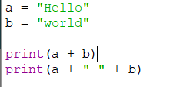
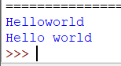
String Concatenation
String concatenation puts two or more strings together
Can be combined with the input( ) function to create personalized strings

Slide 54
String Functions
A function is a piece of code written to carry out a specified task and is called by a name.
The following are built-in functions: print( ); input( ); len( )
len( ) returns the length of a string:
dna_seq = “ANTGCTG”
len(dna_seq)
* Note: using the len( ) function in batch mode will not return a value without adding a print( ) statement

Slide 55
String Methods
5) split(): Splits the string into a list of substrings based on a delimiter.
split_list = dna_seq.split("T")
print(split_list) # Output: ['AN', ‘GC’,’G’]
6) replace(): Replaces occurrences of a specified substring with another substring.
new_seq = dna_seq.replace("TG", "AA")
print(new_seq) # Output: ANAACAA
7) startswith(): Checks if the string starts with a specified substring.
starts_with_AN = dna_seq.startswith("AN")
print(starts_with_AN) # Output: True
8) endswith(): Checks if the string ends with a specified substring.
ends_with_TG = dna_seq.endswith("TG")
print(ends_with_TG) # Output: True
1) len(): Returns the length of the string.
dna_seq = "ANTGCTG"
length = len(dna_seq)
print(length) # Output: 7
2) lower(): Converts the string to lowercase.
lower_seq = dna_seq.lower()
print(lower_seq) # Output: antgctg
3) upper(): Converts the string to uppercase.
upper_seq = dna_seq.upper()
print(upper_seq) # Output: ANTGCTG
4) strip(): Removes leading and trailing whitespace from the string.
stripped_seq = dna_seq.strip()
print(stripped_seq) # Output: ANTGCTG

Slide 56
In-Class Exercise
dnaseq = ATgTCtCATTcAAAGCANNNNNATGCGAGTTATGA”
Write a simple Python script to:
Replace “N” into “G” in the variable dnaseq, and print the sequence
Capitalize all the lowercase letters in the variable dnaseq and print the sequence
Get the length of dnaseq and print the length
Calculate the number of “G” in dnaseq and print the number
Hints:
Write comments as necessary
Use string methods and functions

Slide 57
Lists
What is a list?
A list is a collection of characters made from zero or more items, separated by commas, and surrounded by square brackets.
Examples:
empty_list = [ ]
weekdays = [“Monday”, “Tuesday”, “Wednesday”, “Thursday”, “Friday”]
birds = [‘emu’, ‘ostrich’, ‘cassowary’]
Items can be of any data type
my_list = [123, ‘John’, ‘Terry’, 1.45, True]

Slide 58
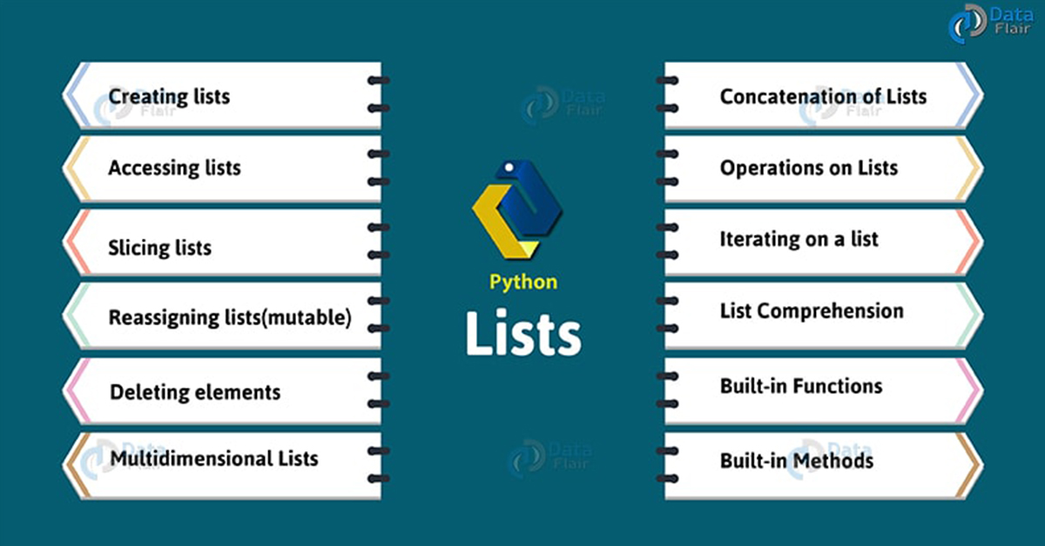
Lists

Slide 59
Lists
# Deleting elements
del fruits[1]
print(fruits)
# Output: ['pear', 'orange']
# Multidimensional Lists # let’s assume a 3x3 matrix
matrix = [[1, 2, 3], [4, 5, 6], [7, 8, 9]]
print(matrix[1][2])
# Output: 6
# Concatenation of Lists
combined_list = fruits + numbers
print(combined_list)
# Output: ['pear', 'orange', 1, 2, 3, 4, 5]
# Operations on Lists
print(len(fruits)) # Output: 2
print(max(numbers)) # Output: 5
print(min(numbers)) # Output: 1
print(sum(numbers)) # Output: 15
# Creating lists
fruits = ['apple', 'banana', 'orange']
numbers = [1, 2, 3, 4, 5]
mixed_list = [1, 'apple', True, 3.14]
# Accessing lists
print(fruits[0])
# Output: apple
# Slicing lists- the last item will be not included
print(numbers[1:4])
# Output: [2, 3, 4]
# Reassigning lists (mutable)
fruits[0] = 'pear'
print(fruits)
# Output: ['pear', 'banana', 'orange']

Slide 60
Lists
# Iterating on a list
for fruit in fruits:
print(fruit)
# Output pear orange
# List Comprehension (a concise and powerful way to create lists
squares = [x**2 for x in numbers]
print(squares)
# Output: [1, 4, 9, 16, 25]
# Built-in Functions
print(len(fruits))
# Output: 2
print(sorted(numbers))
# Output: [1, 2, 3, 4, 5]
print(sum(numbers))
# Output: 15
# Built-in Methods
fruits.append('grape')
print(fruits)
# Output: ['pear', 'orange', 'grape’]
fruits.remove('pear')
print(fruits)
# Output: ['orange', 'grape’]
fruits.insert(1, 'apple')
print(fruits)
# Output: ['orange', 'apple', 'grape']

Slide 61
Lists
How to access list elements or items:
As with strings, you can extract a single value from a list by indexing.
>>>sequences = [“AAA”, “TTT”, “GGG”]
>>>sequences[0]
‘AAA’
>>>sequences[1]
‘TTT’

Slide 62
Changing a List / Changing a String
Lists
Lists are mutable
>>>sequences = [“AAA”, “TTT”, “GGG”]
>>>sequences[2] = “CCC”
>>>print(sequences)
[‘AAA’, ‘TTT’, ‘CCC’]
Strings
Strings are immutable
DNAseq = “ANTGCTG”
DNAseq[1] = “G”
Returns a type error

Slide 63
Any Questions

